Slide 1
SEMANTIC SEARCH ON CODEBASES
Presenters : Roll No.:
Maj Ashish Ahluwalia 21111073
Binay Kumar Suna 21111021
Chabil Kansal 21111022
Shubham Sinha 21111409
Supervised By : Prof. Arnab Bhattacharya

Slide 2
BRIEF OVERVIEW:
Finding our desired snippet of code from large repository in a jiffy. This would be unlike the tedious traditional experience of finding code sections through word search using Ctrl+F.
We could give a short description of what we intend to find and let the machine using its understanding of code find the code snippet matching for the given description.

Slide 3
Approach 1

Slide 4
S.No | TOPICS
1. | Data Implementation
2. | Translating Function to its English Description (Docstring) using Transformer
3. | Searching Via Semantic Similarity
4. | Building the Search engine Web Application

Slide 5
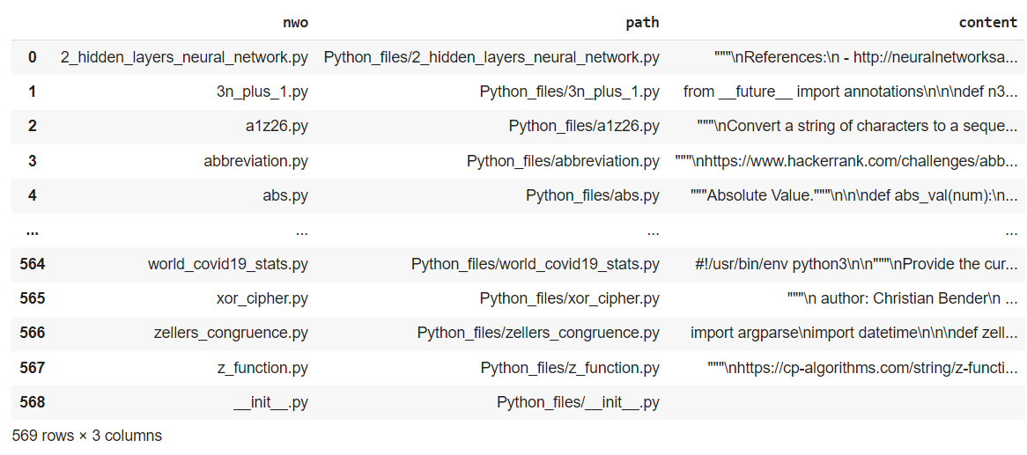
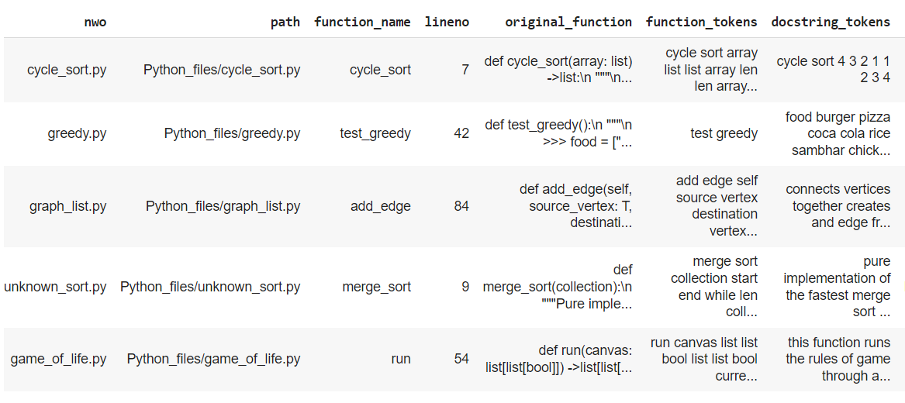
Data Implementation
Data Source
Data Collection
Data Preprocessing
After we extracted the function definition and its docstring we tokenized each of them to remove punctuation, decorators and convert all the tokens to lower case. Once we have extracted our function-docstring pairs and their tokens which are free from decorators and other unwanted elements,we stack our findings in a data-frame with every row containing details about a function and its corresponding docstring.
These dataset contain hundred of files containing python codes. Each python file contains various functions/classes and their descriptions in the form of comments.
For analysing the data and better pre-processing it, the entire data is loaded into a csv format containing various columns .(total - 1,50,000+ files)

Slide 6
Translating Function to its English Description (Docstring) using Transformer
Generating a Vocabulary
Encoder Function
Sorting the Data
Decoder Function
We begin with generating two separate vocabularies one from our function tokens and the other from the docstring tokens and subsequently use these vocabularies to convert our function and docstring tokens into ids(which is the token’s index position in the vocabulary)
After modifying the tokenizer we need to make few changes in encode function of the transformer model..
Sorting the data set based on the count of function tokens in an entry will cause all similar sized inputs being together in a batch,which will reduce the padding tokens..
Avoid shuffling the data
Decoder function uses the the representation generated by encoder and generates the english meaning out of it.
AFTER TRAINING THE MODEL WE GET A FUNCTION IN A TEXT FORM

Slide 7
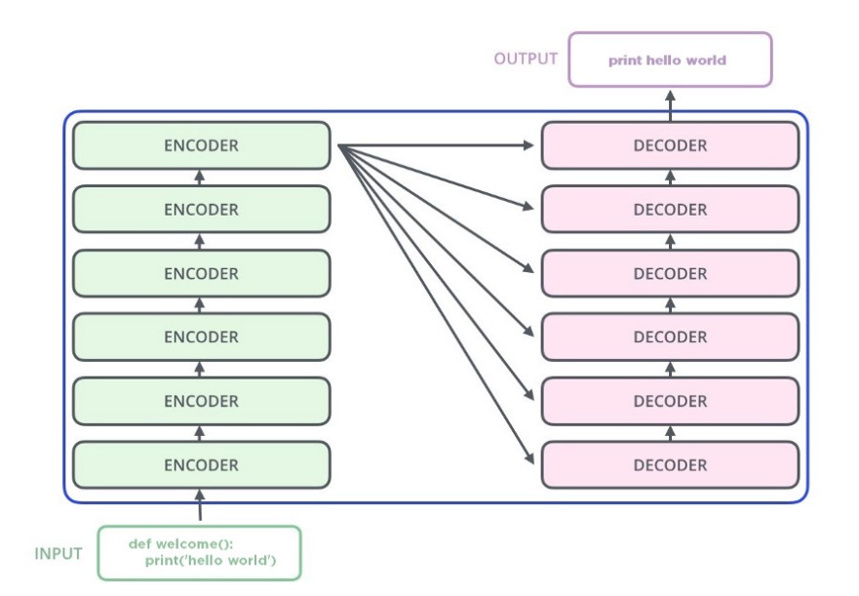
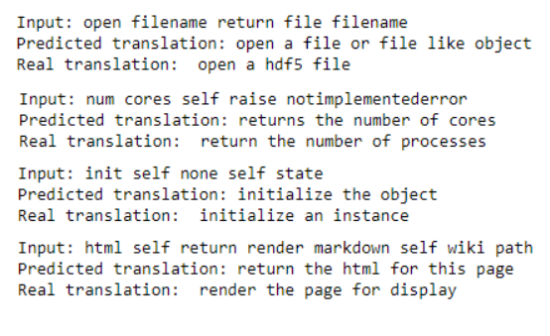
Translating Function to its English Description (Docstring) using Transformer
Transformer Translation Function in English
Translation Made by the Model

Slide 8
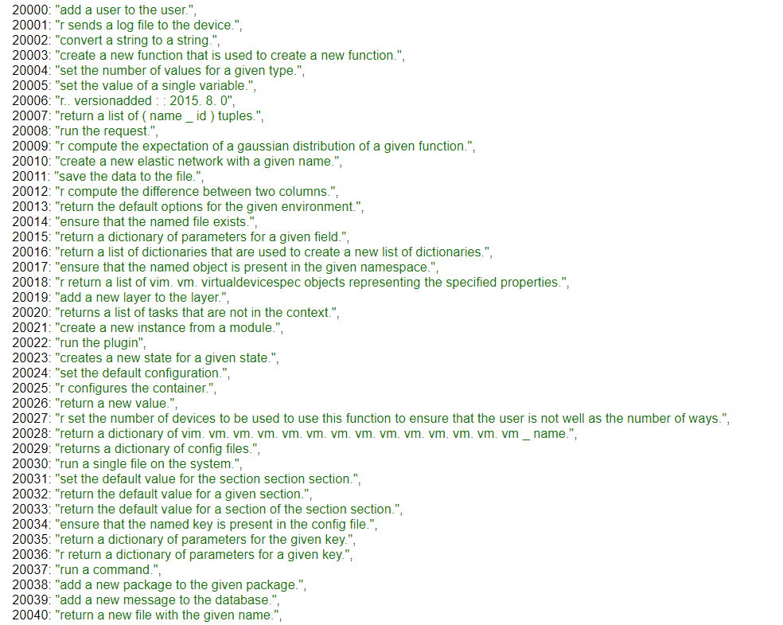
Translating Function to its English Description (Docstring) using Transformer
Translation File

Slide 9
Searching Via Semantic Similarity
Semantic similarity scores words based on how similar they are, even if they are not exact matches. It borrows techniques from Natural Language Processing (NLP).
We have used the word embedding model GloVe which maps words into numerical vectors which are points in a multi-dimensional space so that words that occur together often are near each other in space.
We create a similarity matrix, that contains the similarity between each pair of words, weighted using the term frequency then calculate the soft cosine similarity (as regular cosine similarity return zero for vectors with no overlapping terms),which considers the word similarity between the query and each of the documents.

Slide 10
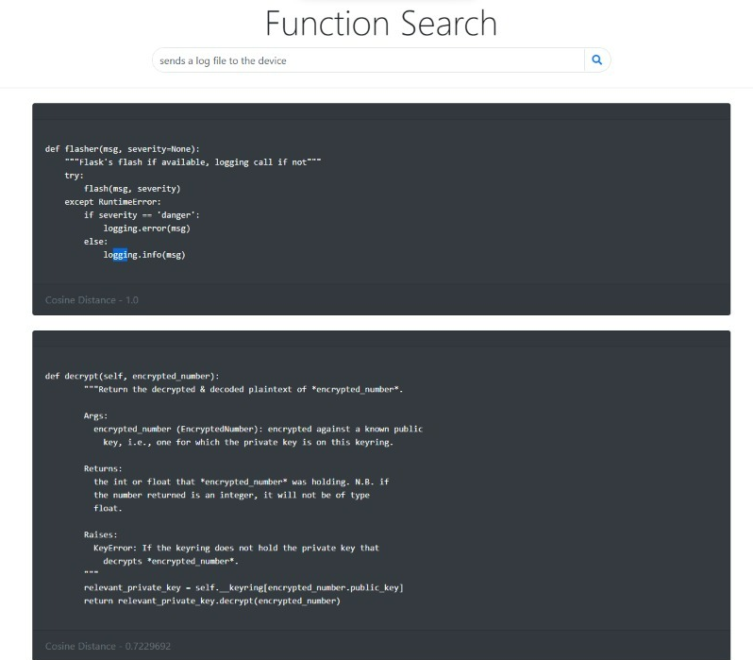
Building the Search engine Web Application
We have used Flask which is a small and lightweight Python web framework that provides useful tools and features that make creating web applications in Python easier.
After receiving the input query the browser embed it as a GET request and convert it to vector for our model. The search function will return us with top five results having the highest cosine similarity.

Slide 11
Approach-2

Slide 12
S.No | TOPICS
1. | Data Implementation ( Same as Approach 1 )
2. | Converting Docstring to Vector
3. | Converting Functions to Vectors
4. | Building the Search Logic

Slide 13
Converting Docstring to Vector
The docstrings are converted to vectors using a pretrained ALBERT model which is fine-tuned on our data set. ALBERT is chosen because its faster to train, low on memory consumption and trains on harder tasks as compared to BERT.
Fine-tune the word embedding weights and the weights of the encoders to make it understand the words and infer its meaning from a computer programming context.
Learn representations for even programming jargons, like ‘SQL, csv ’ etc., which might not be present in its own vocabulary.

Slide 14
Converting Functions to Vectors
To convert the functions into 768-dimensional vectors such that the function vector and the docstring vector are in a shared vector space.
State-of-the-art results in the field of machine translation.
Remove the decoder from the transformer architecture and use the trained encoders of the transformer to give an encoded representation of the function.
Send the input from the encoder layers of the transformer to an LSTM layer which passes its output to a dense layer to finally output a 768-dimensional vector.

Slide 15
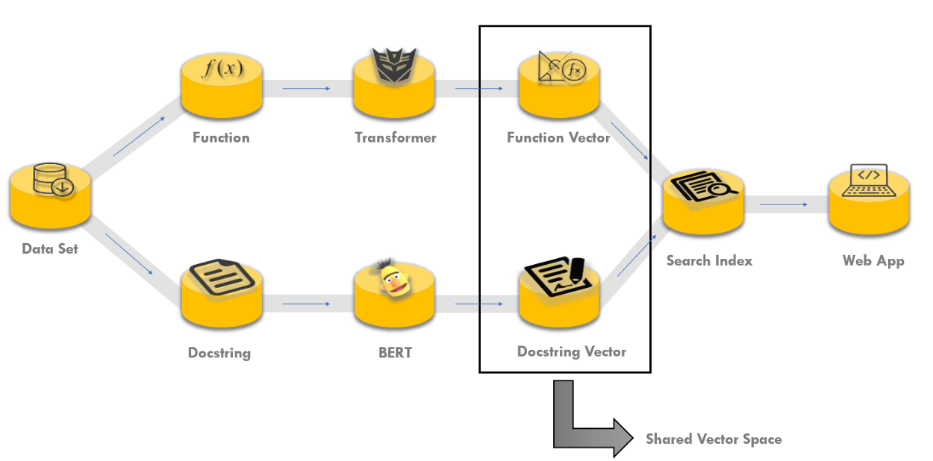
Building the Search Logic

Slide 16
Used Non-Metric Space Library (nmslib)
Encode the search query to a vector using our trained ALBERT model.
Function vectors similar to the search query vector are searched and we are returned index values and the distances of five nearest neighbors to the search query.
Extract its details using the index value which corresponds to its index value in the data set and display the results

Slide 17


